Slide 1
Review Session 1
Kathleen Torkko
October 16, 2019

Slide 2
Review:
p<0.05 from SEM, CI
Determining “outliers”
Determining most skew from box plots
Experimental unit, statistical unit
Practice t-tests, chi-square, McNemar’s test etc. as time allows

Slide 3
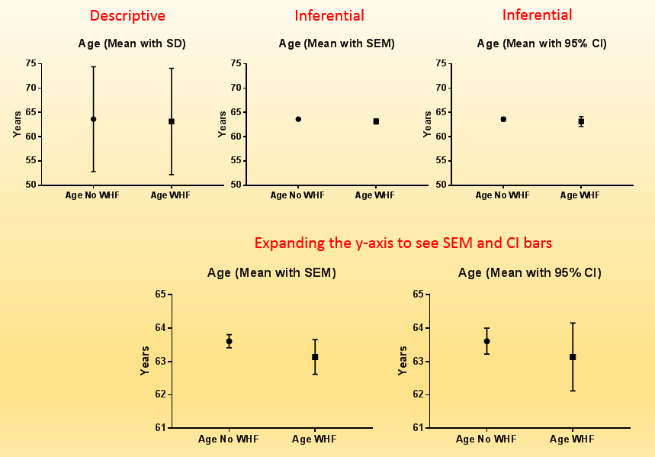
95%CI are wider than SEM, but you are more likely to “capture” the true population value.

Slide 4
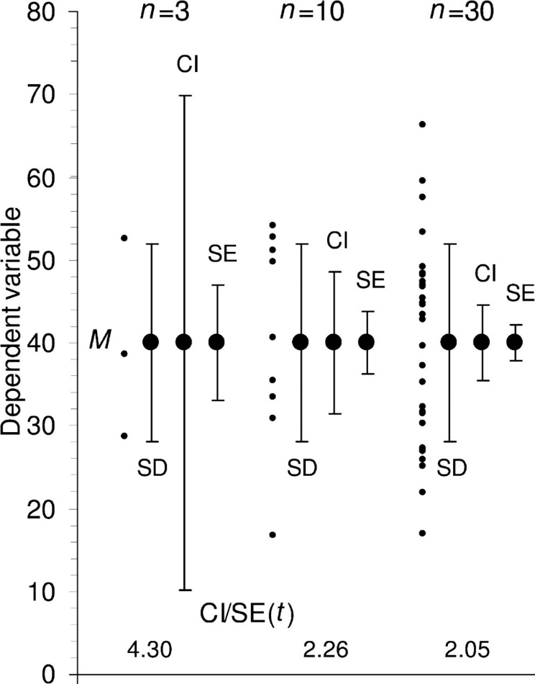
Descriptive (SD) and Inferential (CI, SEM) Error Bars
SDs provide descriptive information, while SEMs and CIs are both relevant to inference and provide information about precision.
Notice that with increasing sample size, SD remain about the same size, but CI and SEM (SE) get smaller.
Cumming G et al. J Cell Biol 2007;177:7-11

Slide 5
Which do I Use: SD or SEM (or 95%CI)?
It depends what your questions are
“What is the variability of my sample data?”
use SD or just graph all data points if n is small (<20)
“What is the likely mean of the population?”
95%CI are valuable
gives a sense of how accurately you have determined the population mean from your sample
“Are groups different determined by a statistical test (do bars overlap)?”
SEM and 95%CI can be informative if you know how to interpret them
Depends on sample size

Slide 6
What Do Scientists Think Error Bars Tell Them?
Most scientists follow the just abutting rule regardless of what the error bars are.
They conclude p<0.05
Expression
(%)
Group 1
Group 2
Belia et al., 2005, Psychological Methods

Slide 7
Using Error Bars to Compare Groups of Data
SD
Demonstrates data variability, but no comparison possible
SEM
If bars overlap, any difference in means p>0.05
If they don’t overlap, the results might be p≤0.05 or they may not
be (depending on n and distance between bars)
95% CI
If bars overlap, p could be ≤0.05 or >0.05
Useful rule of thumb: If two 95% CI error bars do not overlap, and the
sample sizes are nearly equal, the difference is statistically significant with a p-value much less than 0.05

Slide 8
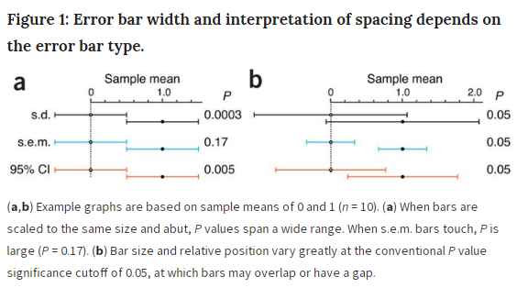
Nat Methods. 2013 Oct;10(10):921-2

Slide 9
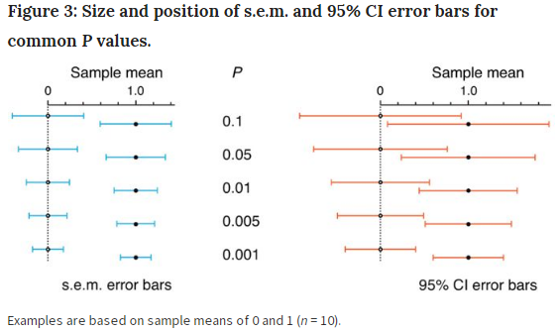
Nat Methods. 2013 Oct;10(10):921-2

Slide 10
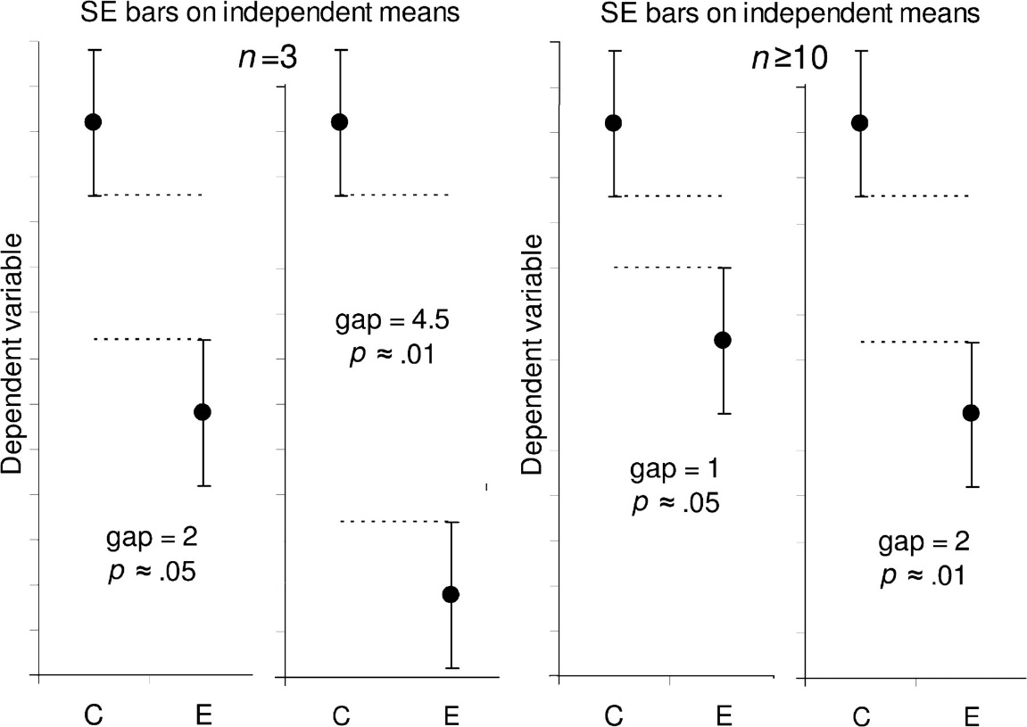
Estimating statistical significance using the overlap rule for SE bars. Here, SE bars are shown on two separate means, for control results C and experimental results E, when n is 3 (left) or n is 10 or more (right). “Gap” refers to the number of error bar arms that would fit between the bottom of the error bars on the controls and the top of the bars on the experimental results; i.e., a gap of 2 means the distance between the C and E error bars is equal to twice the average of the SEs for the two samples. When n = 3, and double the length of the SE error bars just touch (i.e., the gap is 2 SEs), P is ∼0.05 (we don't recommend using error bars where n = 3 or some other very small value, but we include rules to help the reader interpret such figures, which are common in experimental biology).
J Cell Biol. 2007 Apr 9;177(1):7-11

Slide 11
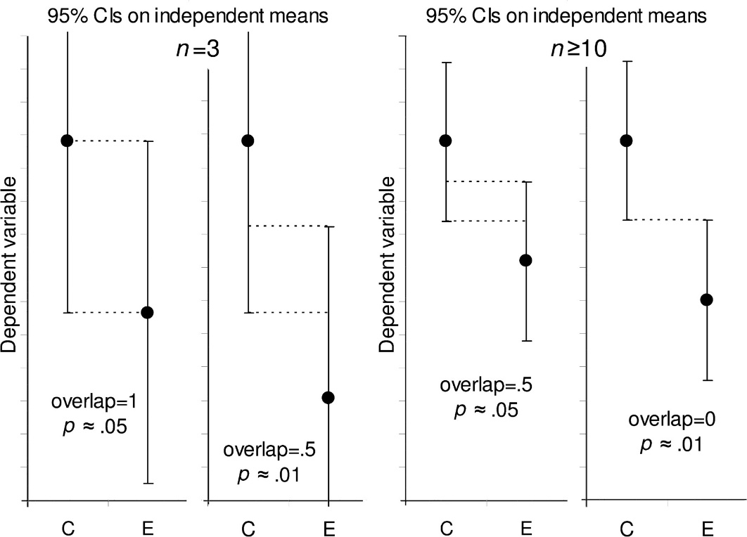
Estimating statistical significance using the overlap rule for 95% CI bars. Here, 95% CI bars are shown on two separate means, for control results C and experimental results E, when n is 3 (left) or n is 10 or more (right). “Overlap” refers to the fraction of the average CI error bar arm, i.e., the average of the control (C) and experimental (E) arms. When n ≥ 10, if CI error bars overlap by half the average arm length, P ≈ 0.05. If the tips of the error bars just touch, P ≈ 0.01.
J Cell Biol. 2007 Apr 9;177(1):7-11

Slide 12
In order to interpret p<0.05 from two bars:
You need to know the bar type and the sample sizes.
Be sure to include this information in your own graphs.

Slide 13
“Outliers”
An outlier is a data point that is outside the range of other values in the dataset
Can be subjective
May be due to
biological variability
experimental or measurement error
If they are real data, do not delete

Slide 14
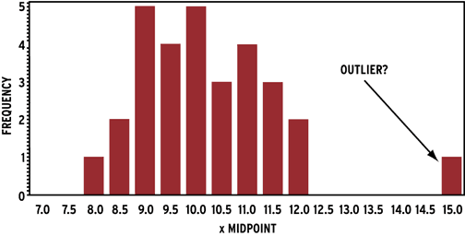
Identifying Outliers
Graph the data and eyeball it
Frequency distribution, scatter, box plots
Two different methods for identifying outliers for a normally distributed dataset:
Interquartile range (IQR) method
Z-score method

Slide 15
Identifying Outliers:
Interquartile Range (IQR) Method
Remember the Tukey whiskers for boxplots
set up a “fence” utilizing Q1 and Q3. Any values that fall outside of this fence are considered outliers.
To build this fence take 1.5 times the IQR and then subtract this value from Q1 and add this value to Q3:
Lower Fence = Q1 – 1.5(IQR); Upper Fence = Q3 + 1.5(IQR)
Observations more than 1.5 IQR below Q1 or more than 1.5 IQR above Q3 are considered outliers.
This is the method that Prism uses to identify “outliers.”
Why 1.5IQR? There is no statistical rationale; it is simply how Tukey decided to do it, and he invented the idea of box-and-whisker plots.

Slide 16
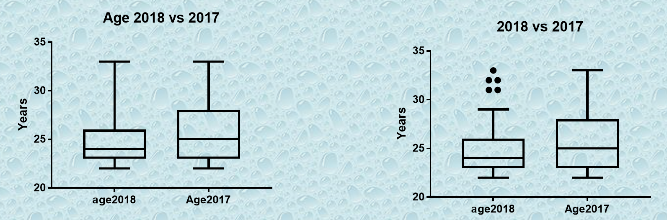
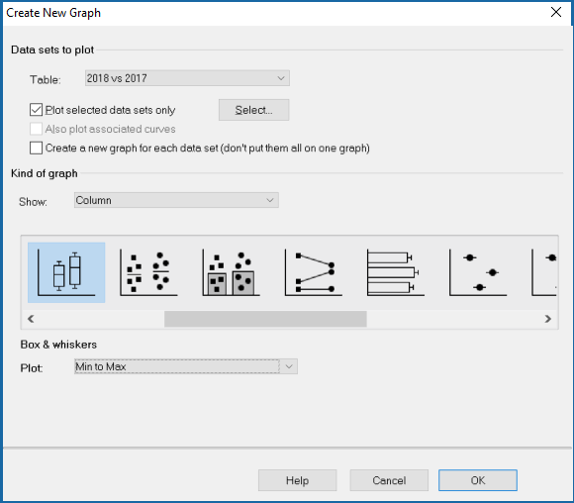
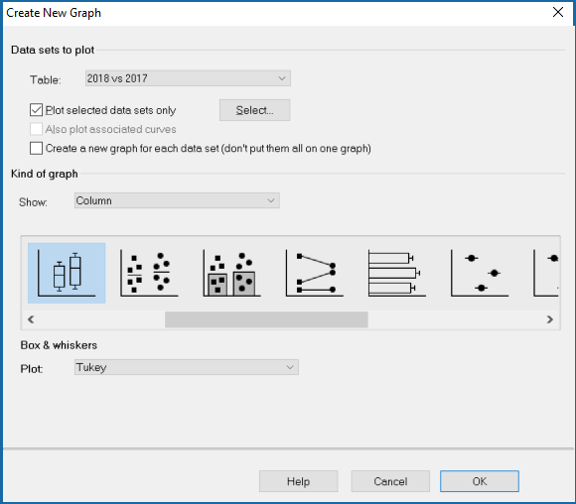

Slide 17
Example: Test Scores, Are there “outliers”?
IQR Method by hand
A teacher wants to examine students’ test scores. Their scores are:
74, 80, 80, 84, 88, 90, 90, 90, 90, 98
2 3 4 5 6 7 8 9 10
The median is 89 [(88 + 90)/2]
Q1=80
Q2=90
IQR = 90 – 80 = 10
1.5 (IQR) = 1.5 (10) = 15
Our “fences” will be 15 points below Q1 and 15 points above Q3.
Lower fence = 80 – 15 = 65 Upper fence = 90 + 15 = 105
Any scores that are less than 65 or greater than 105 are outliers. In this case, there are no outliers.
But be cautious, because the statistics say they are outliers, it doesn’t tell us the data may be real and evidence of important biological variation
Rank

Slide 18
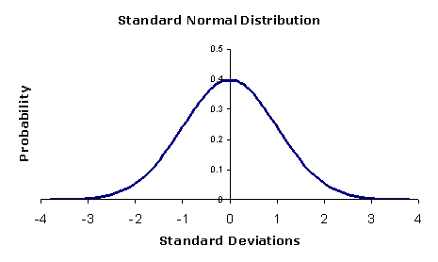
z Score method
Example: Test Scores, Are there “outliers”?
It is unusual for an observation to fall more than 3 standard deviations from the mean. Thus, any observation with a z score less than -3 or greater than +3 could be considered a potential outlier.
But remember, any statistical “outlier” may be real data

Slide 19
Example: Test Scores, Are there “outliers”?
“z” Score method
Example: Test Scores
A teacher wants to examine students’ test scores. Their scores are: 74, 88, 78, 90, 94, 90, 84, 90, 98, and 80
First, must compute mean and SD. Prism gives us mean (xbar)= 86.6, SD = 7.5
Now we can compute the z score for each student score using the formula
“z” = (x-xbar)/s
Student | X | xbar | x-xbar | SD | z score
1 | 74 | 86.6 | -12.6 | 7.5 | -1.7
2 | 88 | 86.6 | 1.4 | 7.5 | 0.2
3 | 78 | 86.6 | -8.6 | 7.5 | -1.1
4 | 90 | 86.6 | 3.4 | 7.5 | 0.5
5 | 94 | 86.6 | 7.4 | 7.5 | 1.0
6 | 90 | 86.6 | 3.4 | 7.5 | 0.5
7 | 84 | 86.6 | -2.6 | 7.5 | -0.3
8 | 90 | 86.6 | 3.4 | 7.5 | 0.5
9 | 98 | 86.6 | 11.4 | 7.5 | 1.5
10 | 80 | 86.6 | -6.6 | 7.5 | -0.9
Any z scores less than -3 or greater than +3 are considered “outliers”. Again, there are no outliers in this distribution.

Slide 20
What to do about an outlier
First, make sure that the data point is not an error
Measurement error
Data entry error
If it is real
Do not automatically delete it despite what formal tests say
Could be a rare but important variation in your data
Data transformation may help
Use a non-parametric test

Slide 21
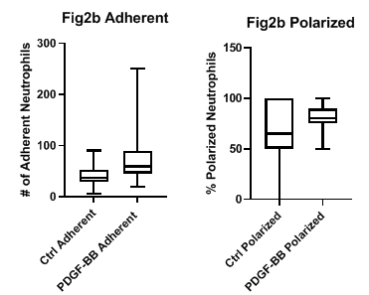
Week 05 Assignment
Based on the box plots, which group looks to be the least symmetrical?

Slide 22
Q16a-d. An experiment was done where cells from the same breast cancer cell line were injected into two mammary pads (one on the right side, one on the left side) of each of 46 mice. The mice were randomized into either placebo or treatment group. The mice were studied for four weeks. At the end of the 4 week period, the volume for each tumor in each animal was measured using calipers. Total tumor burden was calculated as the sum of volumes of the tumors on the right and left sides.
Q16a. What is the total n for this experiment? (1 pt) 46
Q16b. What is the experimental unit? (1 pt) The mouse
Q16c. What is the observational unit? (1 pt) The tumor
Q16d. What is the statistical unit? (1 pt) The mouse

Slide 23

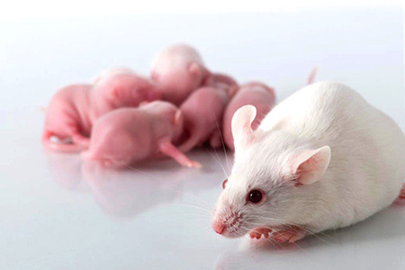
The Experimental Unit of Biological Samples
The experimental unit is the physical entity which can be assigned, at random, to a treatment.
Commonly it is an individual human, animal
The experimental unit is also usually the unit of statistical analysis.

Slide 24

Example – An agricultural experimental station is going to test two varieties of wheat each grown on two plots of land chosen randomly. The grain yield will be measured for each plot at the end of a fixed growth period.
2 plots x 2 wheat varieties = 4 plots total (n = 4)
“Treatment”:
Varieties of wheat
Outcome:
grain yield
Experimental unit:
plots
Observational unit:
plots

